Slide 1
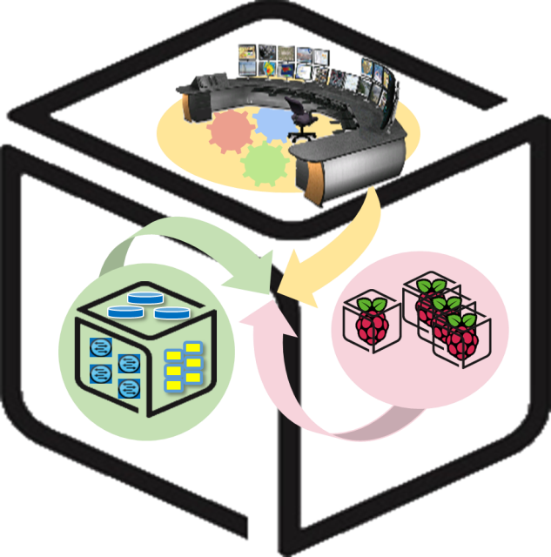



Computer Systems
For AI-inspired Cloud
Theory & Lab.
Lab #6: Analytics
https://github.com/SmartX-Labs/SmartX-Mini-MOOC

Slide 2
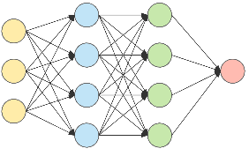
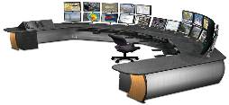








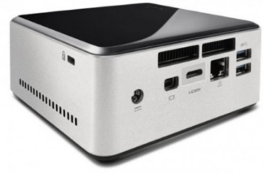

Analytics Lab: Concept
Cluster Resource Pool
Rook
Kubernetes Master (NUC 1)
Kubernetes Worker 1
(NUC 2)
Switch
Kubernetes Worker 2
(NUC 3)

Slide 3
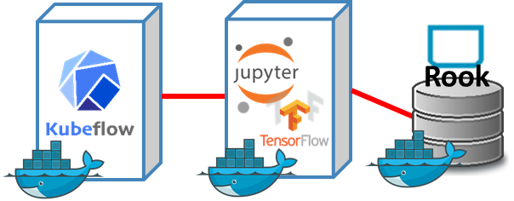

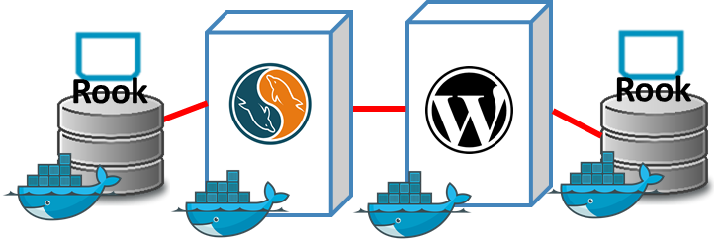
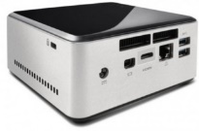


SmartX Labs #1/#5/#6: Relationship
Analytics Lab
(Intelligence Lab)
Cluster Lab
Box Lab

Slide 4



Theory

Slide 5
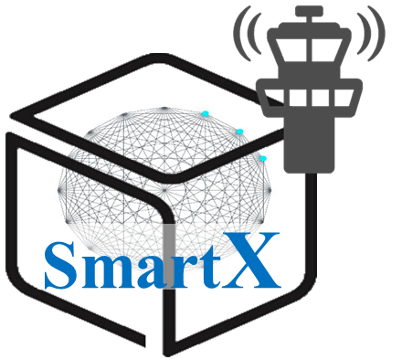



SmartX Cluster: Inter-connected SmartX Boxes
Computing Cluster is a form of computing in which a group of computers are linked together so that they can act like a single entity
Functions
Analytics Functions
Box
Cluster Resource
Pool
Box
Box
Cluster

Slide 6
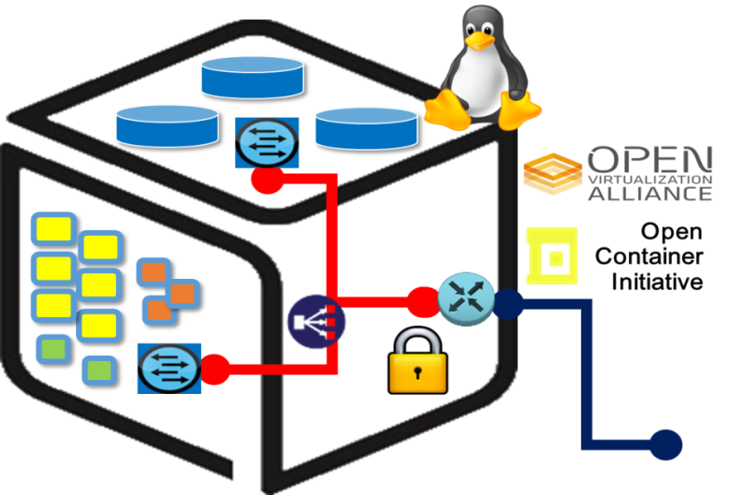
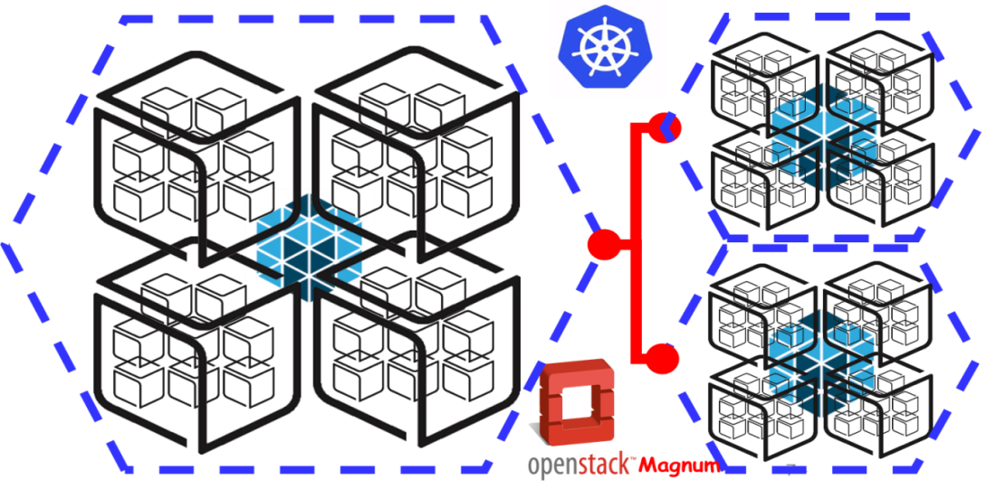
Inter-Connected Functions inside a Box & across Clusters
p+v+c Harmonization Challenge:
p(Baremetal) + v(VM) + c(Container)
Inside a Box
Across Clusters

Slide 7
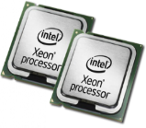


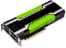











Computer System: Resource Scaling/Pooling with Clustering
NVMe Flash
Scale Out
Scale Up
HBM
Smart NIC
HPC +
HPDA (BigData)
➔ AI (ML/DL)

Slide 8
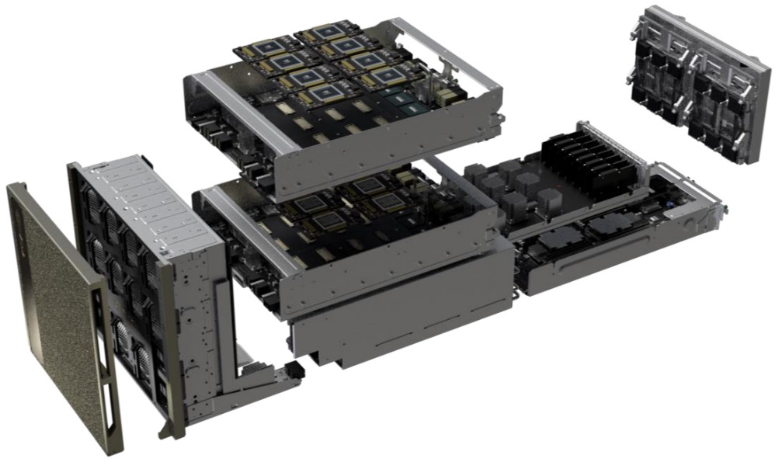




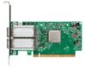

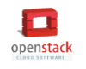
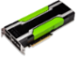


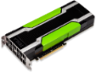

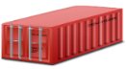
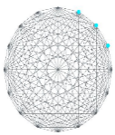






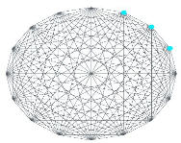
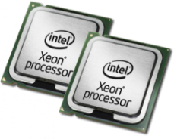

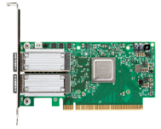
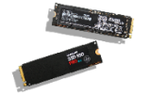

Cluster for AI Computing
HPC + HPDA (BigData)
➔ AI (ML/DL)
Nvidia DGX-2
Intelligence Center
Multi-node AI Computing Cluster with Optimized DL Tools
GPU Acceleration
Container Orchestration
GPU Cards
Cloud Storage Cluster
Parallel File System
Cloud Storage
NVMe SSDs
Smart NICs

Slide 9

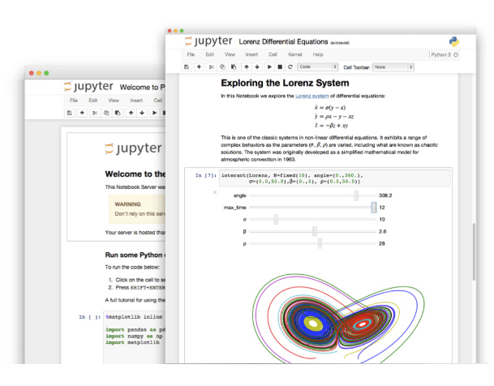

Machine Learning: TensorFlow &
Jupyter Notebook
TensorFlow is an open-source machine learning library for research and production. TensorFlow offers APIs for beginners and experts to develop for desktop, mobile, web, and cloud.
https://github.com/tensorflow/tensorflow
Jupyter Notebook is an open-source web application that allows you to create and share documents that contain live code, equations, visualizations and narrative text. Uses include: data cleaning and transformation, numerical simulation, statistical modeling, data visualization, machine learning, and much more.

Slide 10

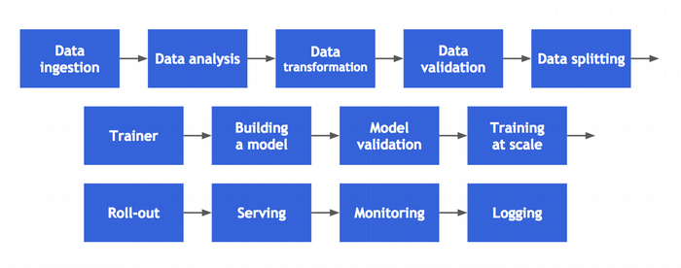


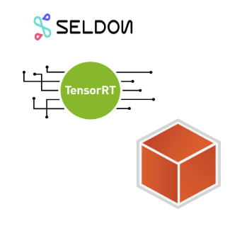
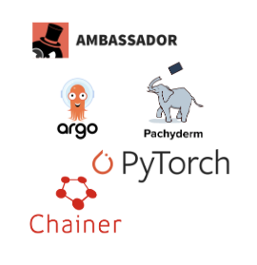
Machine Learning: Kubeflow
The Kubeflow project is dedicated to making deployments of machine learning (ML) workflows on Kubernetes simple, portable and scalable. Our goal is not to recreate other services, but to provide a straightforward way to deploy best-of-breed open-source systems for ML to diverse infrastructures. Anywhere you are running Kubernetes, you should be able to run Kubeflow.
TesorFlow
model Training
Model serving
Multi-ML framework
Notebooks
https://www.kubeflow.org/

Slide 11



MNIST handwritten digit Classification
The MNIST database (Modified National Institute of Standards and Technology database) is a large database of handwritten digits that is commonly used for training various image processing systems.[1][2] The database is also widely used for training and testing in the field of machine learning.
https://towardsdatascience.com

Slide 12
Practice

Slide 13
Analytics Lab: Concept
You
Cluster Resource Pool
Rook
Kubernetes Master (NUC 1)
Kubernetes Worker 1
(NUC 2)
Switch
Kubernetes Worker 2
(NUC 3)

Slide 14
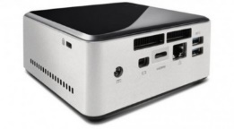

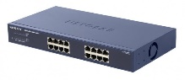
NAME: NUC5i5MYHE (NUC PC) CPU: i5-5300U @2.30GHz CORE: 4 Memory: 16GB DDR3 HDD: 94GB
#0 - Lab Preparation (1/2)
Wired connection
NAME: netgear prosafe 16 port gigabit switch(Switch) Network Ports: 16 auto-sensing 10/100/1000 Mbps Ethernet ports

Slide 15
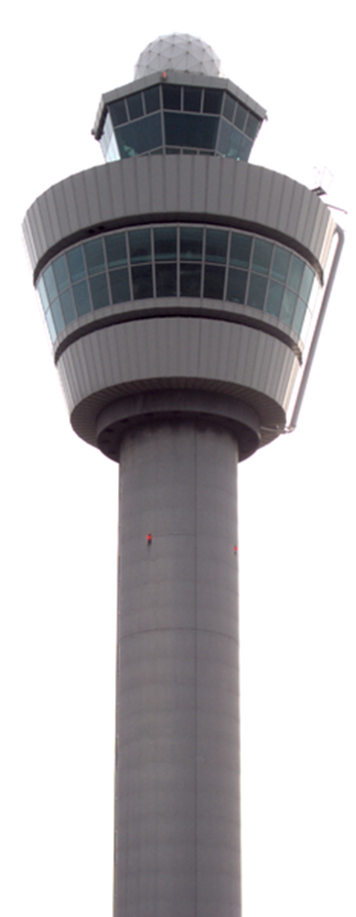
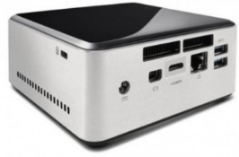
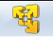
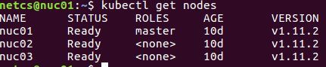
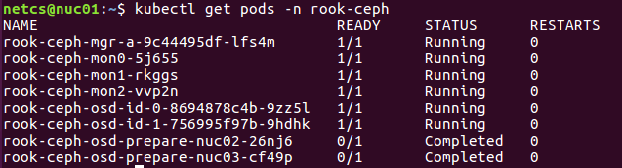
#0 - Lab Preparation (2/2)
- Check your cluster is running healthy
For NUC1
$ Kubectl get nodes
Check all nodes are ready.
$ Kubectl get pods –n rook-ceph
Check all nodes are ready
Check Rook are running healthy on your cluster.

Slide 16

#1-1 Cluster Preparations for ML:
Kubeflow Installation (1/3)
For NUC1
Install prerequisites for kubeflow: Ksonnet Installation
$ sudo su
$ wget https://dl.google.com/go/go1.11.2.linux-amd64.tar.gz
$ tar -C /usr/local -xzf go1.11.2.linux-amd64.tar.gz
$ export PATH=$PATH:/usr/local/go/bin
$ GOPATH=/root/go/
$ go get github.com/ksonnet/ksonnet
$ cd $GOPATH/src/github.com/ksonnet/ksonnet
$ make install
$ exit → Come out of root user
Set Rook Storageclass to default for kubeflow
$ kubectl patch storageclass rook-ceph-block -p '{"metadata": {"annotations":{"storageclass.kubernetes.io/is-default-class":"true"}}}'
$ kubectl get storageclasses

Slide 17
#1-1 Cluster Preparations for ML:
Kubeflow Installation (2/3)
For NUC1
Install Kubeflow
$ mkdir ~/kubeflow
$ cd ~/kubeflow
$ export KUBEFLOW_TAG=v0.3.1
$ curl https://raw.githubusercontent.com/kubeflow/kubeflow/${KUBEFLOW_TAG}/scripts/download.sh | bash
$ ~/kubeflow/scripts/kfctl.sh init kubeflow_app --platform none
$ cd kubeflow_app
$ ~/kubeflow/scripts/kfctl.sh generate k8s
$ cd ~/kubeflow/kubeflow_app/ks_app
$ ks param set jupyterhub serviceType NodePort
$ cd ~/kubeflow/kubeflow_apps
$ ~/kubeflow/scripts/kfctl.sh apply k8s

Slide 18
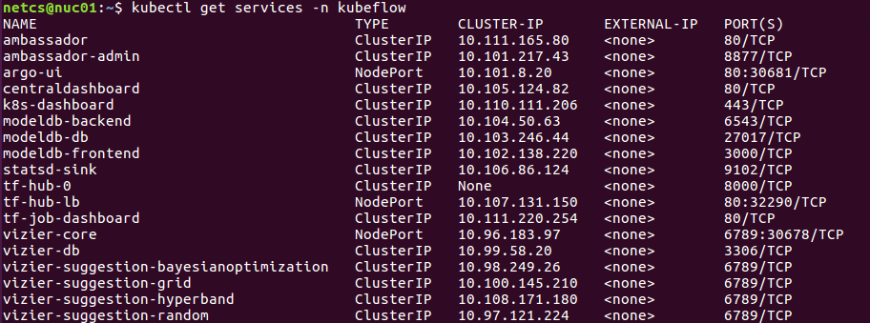
#1-1 Cluster Preparations for ML:
Kubeflow Installation (3/3)
For NUC1
Check Kubeflow is running healthy
$ kubectl get pods -n kubeflow
Check the exposed port to access Jupyter hub
$ kubectl get services –n kubeflow
You can access Jupyter hub at this address
http://nuc01_IP:Exposed_port

Slide 19
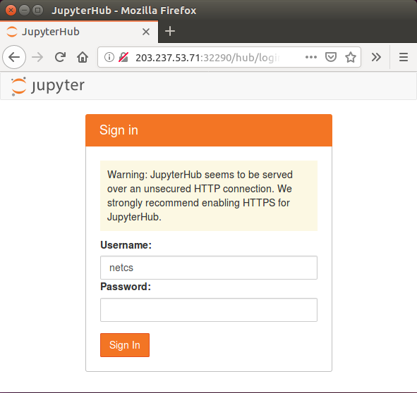
#1-2 Deploy a ML Container:
Create a Jupyter Notebook (1/3)
For NUC1
Open a web browser and enter the Jupyter hub address
http://nuc01_IP:Exposed_port
Enter your username and click ‘Sign In’ button (you don’t have to enter a password)

Slide 20
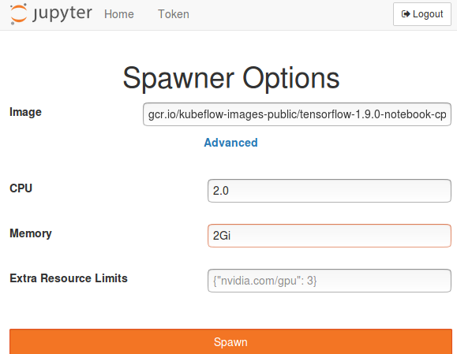
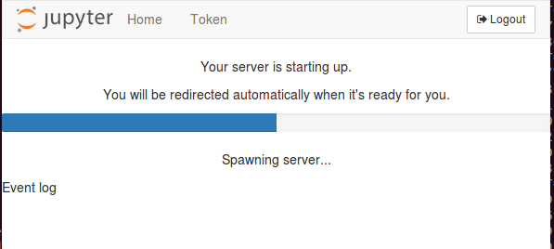
#1-2 Deploy a ML Container:
Create a Jupyter Notebook (2/3)
For NUC1
In Spawner page, you can choose container image and the size of resources to create a Jupyter Notebook container for Machine Learning
Select or enter the options as below
Image: gcr.io/kubeflow-images-public/tensorflow-1.9.0-notebook-cpu:v0.3.1
CPU: 2
Memory: 2Gi
Click Spawn Button and you need to wait for a while

Slide 21
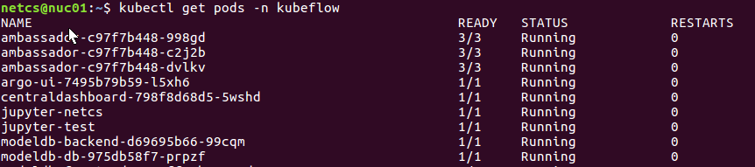
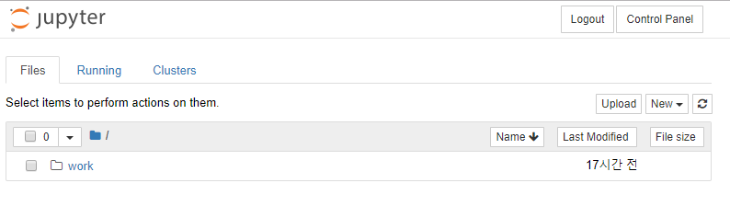
#1-2 Deploy a ML Container:
Create a Jupyter Notebook (3/3)
For NUC1
You can see your Jupyter notebook container is deployed as a pod on cluster
$ kubectl get pods –n kubeflow
Now your Jupyter notebook is created…

Slide 22
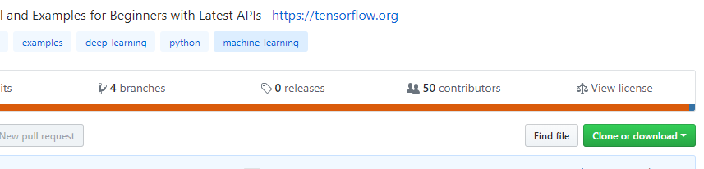
#2-1 Running Analytics code:
Running a Sample ML Code (1/3)
For NUC01
Download sample notebook including MNIST Machine Learning Code
$ git clone https://github.com/aymericdamien/TensorFlow-Examples/
Or Download from web browser as below. (you need to unzip the file)
TensorFlow-Examples-master\notebooks\3_NeuralNetwork\convolutional_network.ipynb
We will upload the sample notebook on your Jupyter and run it.
The notebook include MNIST machine learning example code.
https://github.com/aymericdamien/TensorFlow-Examples/

Slide 23
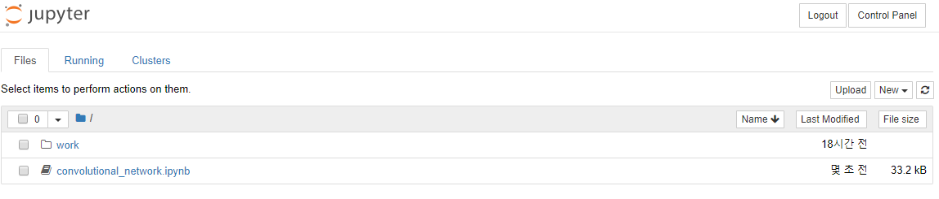
#2-1 Running Analytics code:
Running a Sample ML Code (2/3)
For NUC1
Remember! we will use this file
TensorFlow-Examples-master\notebooks\3_NeuralNetwork\convolutional_network.ipynb
Press upload button to upload the sample notebook
Click it to open the notebook

Slide 24
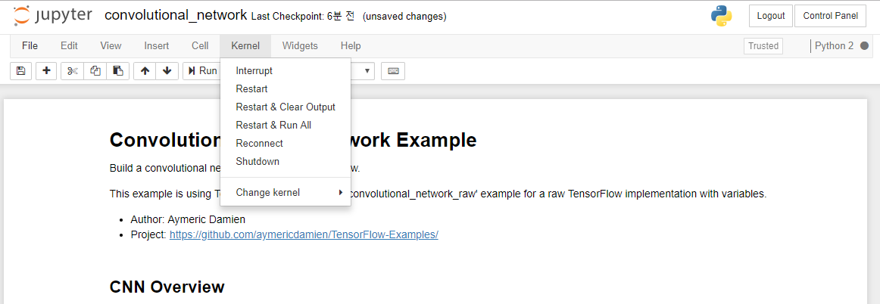
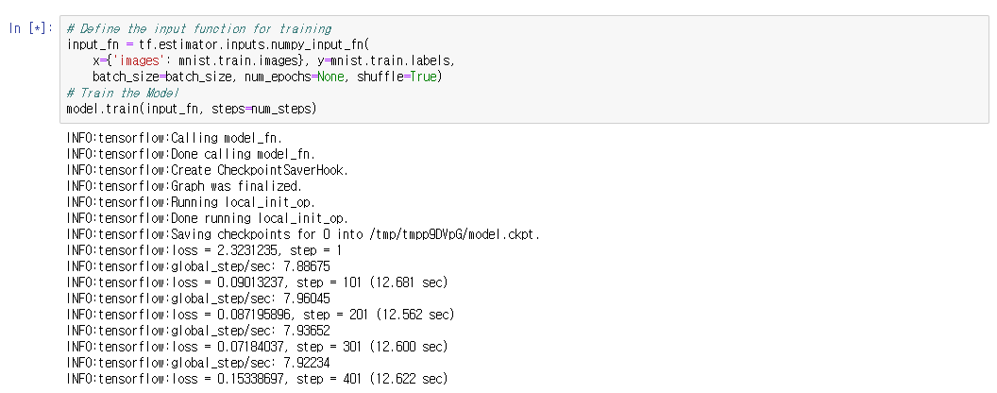
#2-1 Running Analytics code:
Running a Sample ML Code (3/3)
For NUC1
Now, you will run the MNIST example code in sample notebook.
Click kernel→ “Restart&Clear Output” button → “Restart&Run All” button
The training takes a few minutes.
…

Slide 25
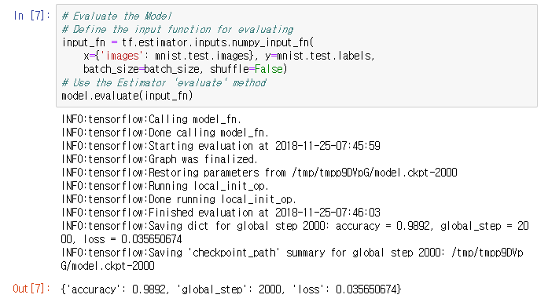
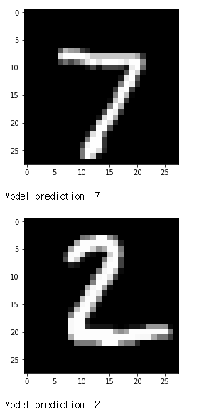
#2-2 Running Analytics code:
Check ML Training results
For NUC1
Your Machine Learning model correctly identified the number in the images!
Check training results
Your model has 98.92% accuracy!

Slide 26
Review

Slide 27
Lab Summary
With Analytics (Intelligence) Lab, you have experimented
How to create ML/DL environment on a container-orchestrated cluster? (Kubeflow, …)
How to operate desired ML training by testing selected ML code (i.e., neural networks) over the prepared training data?
Do you understand the overall workflow for running ML/DL?

Slide 28
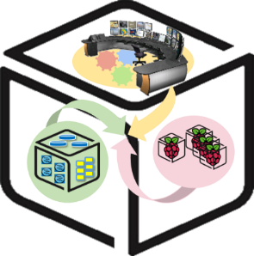
Thank You for Your Attention
Any Questions?
mini@smartx.kr

